Slide 1
Processing of Atomic Resolution Images and Multispectral Data
Stephen Jesse, Alex Belianninov, Suhas Somnath, Chris Smith, Rama Vasudevan, Noumanne Laanait

Slide 2
Outline
Setting up images for multivariate analysis
Multivariate analysis on imaging data
De-noising
PCA
K-means
Atom finding (pattern matching)
Analysis on found atoms
4D-STEM with multivariate analysis

Slide 3
Image Processing using SVD How can you express 2D images in a way that you can use Multivariate Techniques?

Slide 4
Image Cleaning: Sliding Window PCA
Tile 2D-image
Reassemble Data for
Multivariate Analysis
…
Tiles (m x m)
(N-m)²
(N-m)²
PCA
N-pixel
m
m
m²
N-pixel

Slide 5
Principal Component Analysis (PCA)
D → USV*
Scree Plot
-ranked significance of PC’s
Information rich
Information Poor
Less-correlated
Noise
Variance
Principle Component

Slide 6
Sliding Window PCA: De-noising
Model Image
window size
PCA cutoff

Slide 7
Sliding Window PCA: De-noising
Experimental Image
Original Image
Removed Noise
De-noised Image

Slide 8
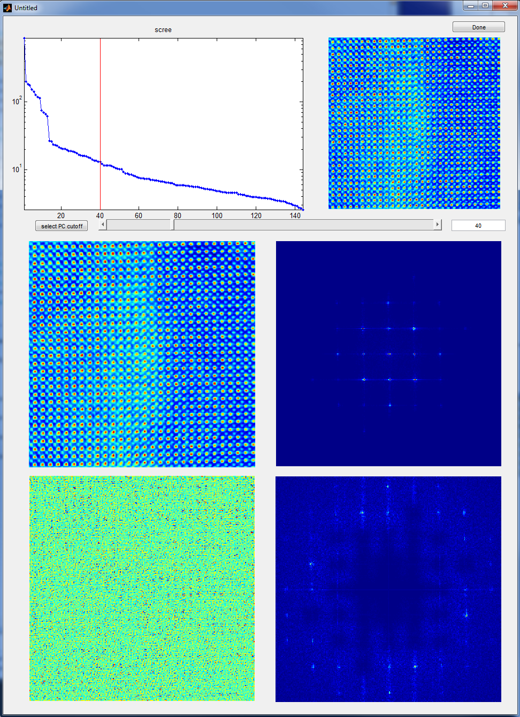
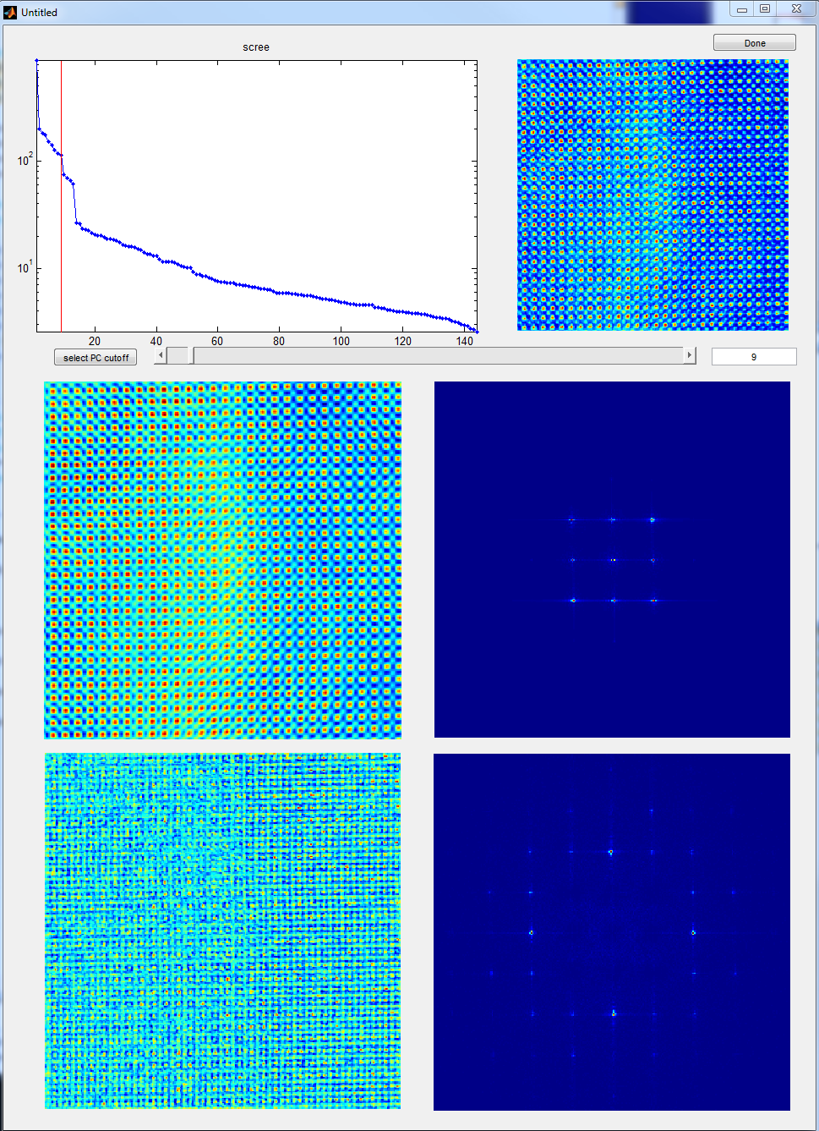
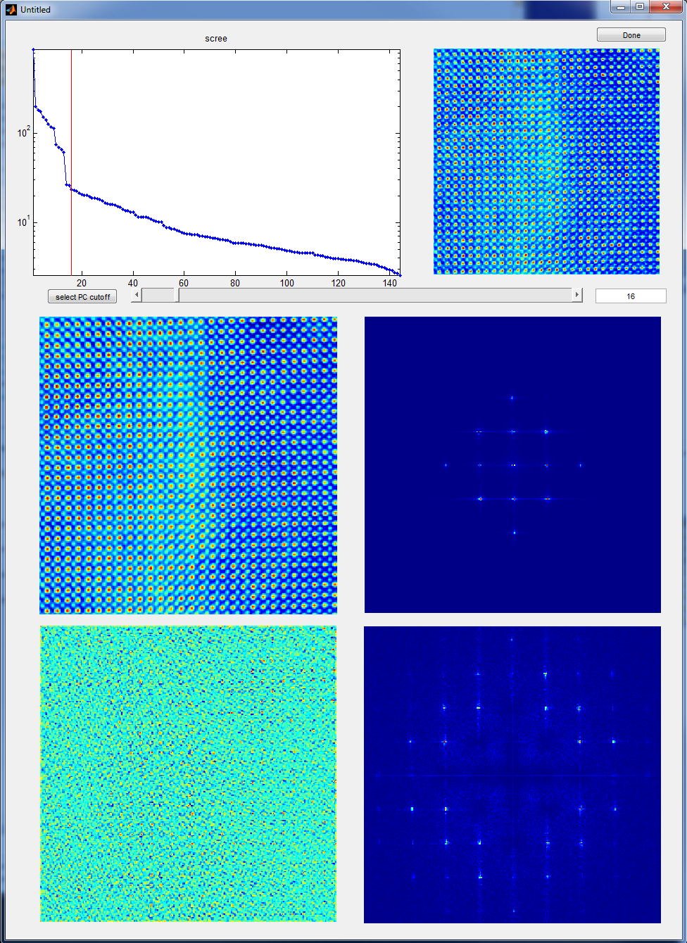
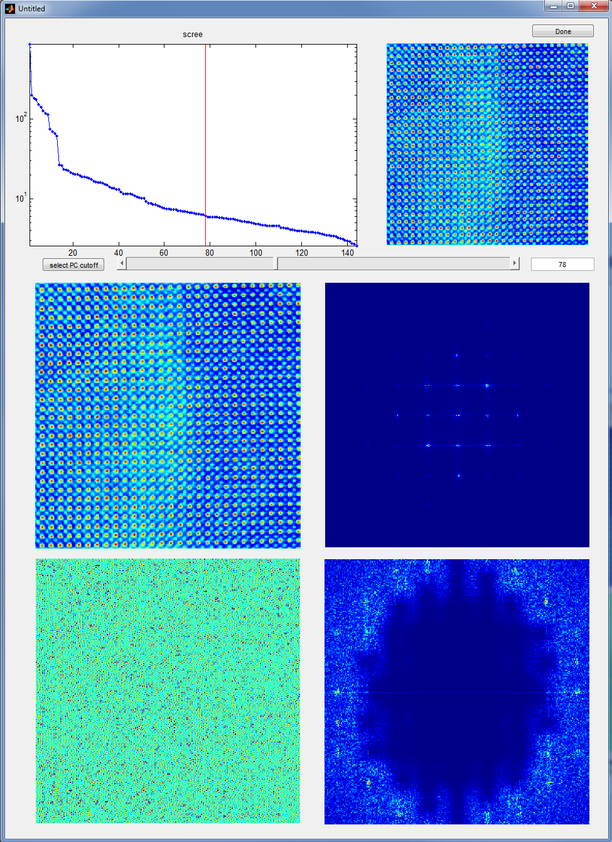
Effects of Number of Retained PC’s
Original image
Cleaned Image
FFT of Cleaned Image
Higher PC’s tend to contain higher frequency Fourier peaks
Automatically removes noise between peaks
Removed Noise
FFT of noise

Slide 9
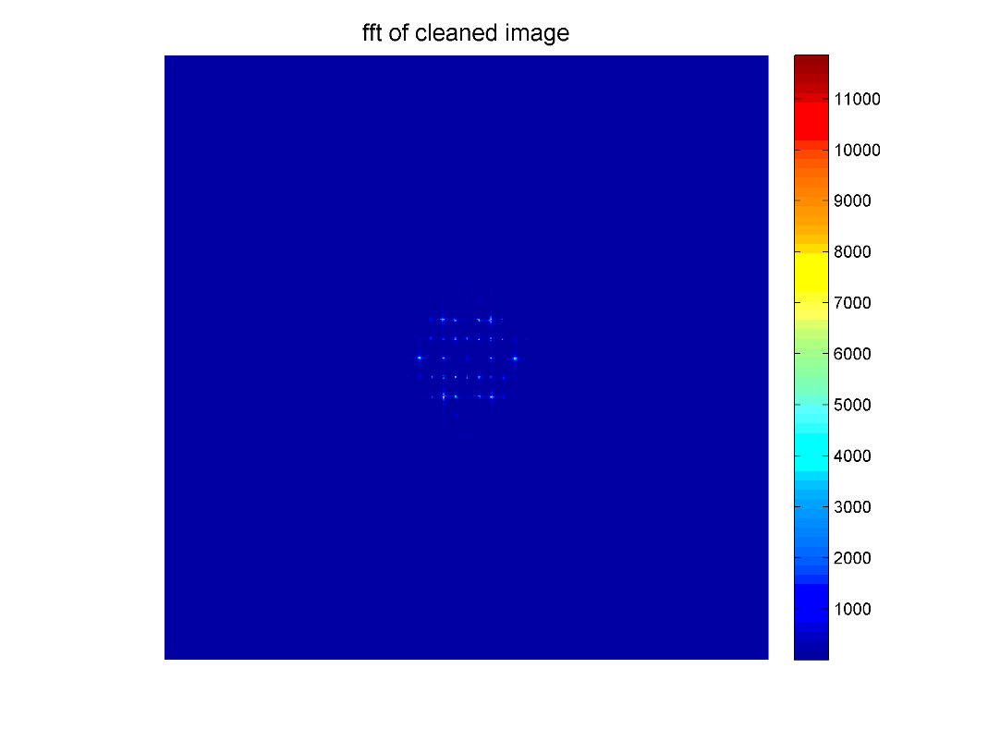
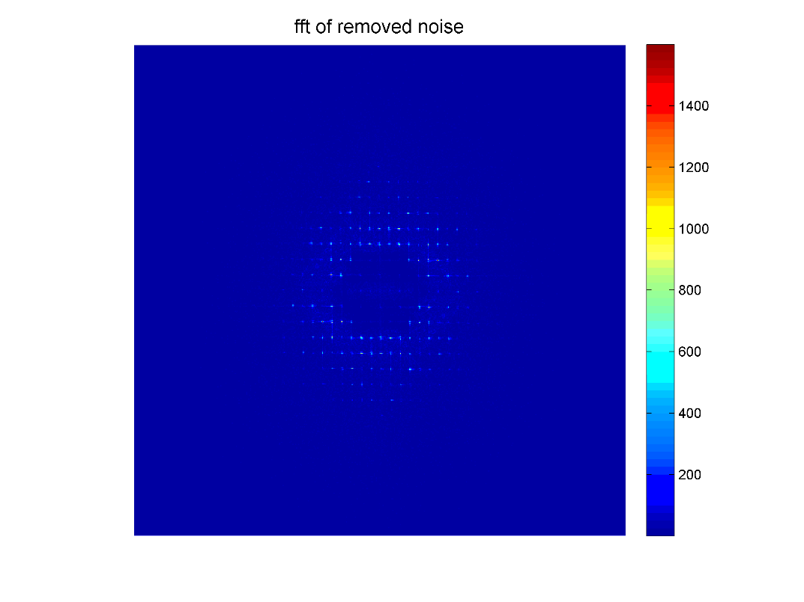
Sliding Window PCA-based Pattern Finding
original
cleaned
removed noise

Slide 10
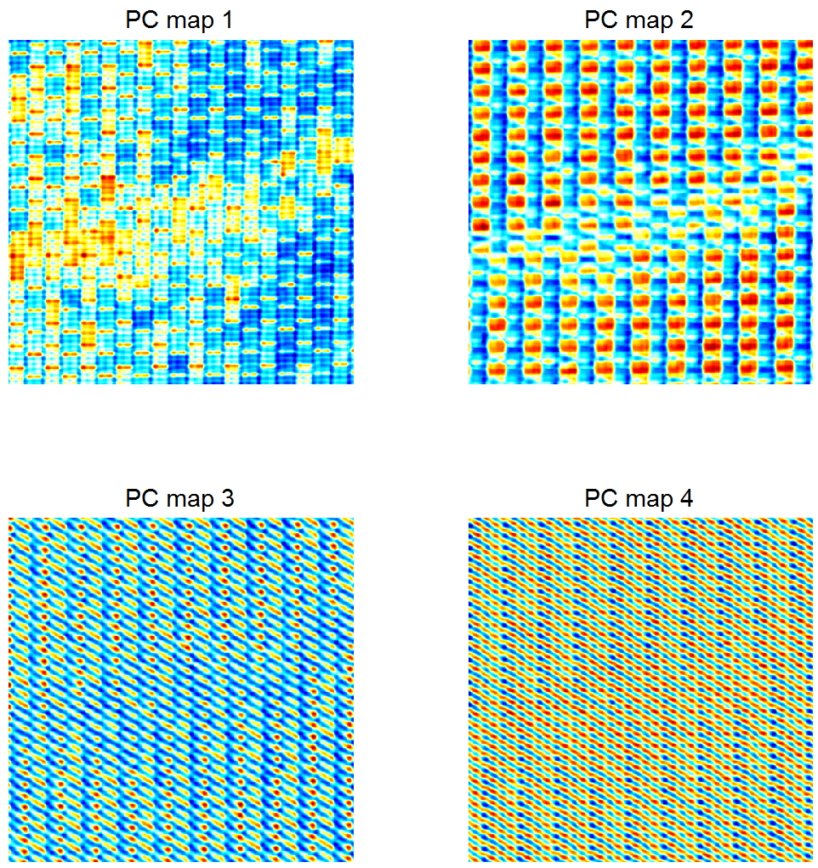
Sliding Window PCA-based Pattern Finding
Original Image
Sliding Window PCA can reveal patterns in images on its own without the need to identify features

Slide 11
Sliding Window PCA-based Pattern Finding ☺☹
Start with a random grid
of smiley and frowny faces

Slide 12
Sliding Window PCA-based Pattern Finding ☺☹
Happy face (red)
Sad face (blue)
Horizontal Transitions
(changes in emotion)
Vertical Transitions

Slide 13
Clustering and Pattern Matching for Atom Finding

Slide 14
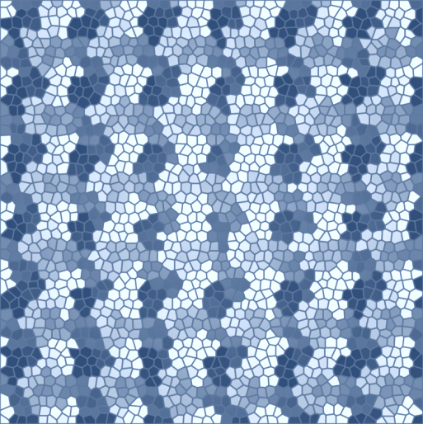

Sliding Window PCA + Clustering
Tile 2D-image
Reassemble Data for
Multivariate Analysis
…
Tiles (m x m)
(N-m)²
PCA
N-pixel
(N-m)²
…
m
m
m²
N-pixel
Cluster on PCA components
Motif Match on Cluster Map
Pattern
Motif
…

Slide 15
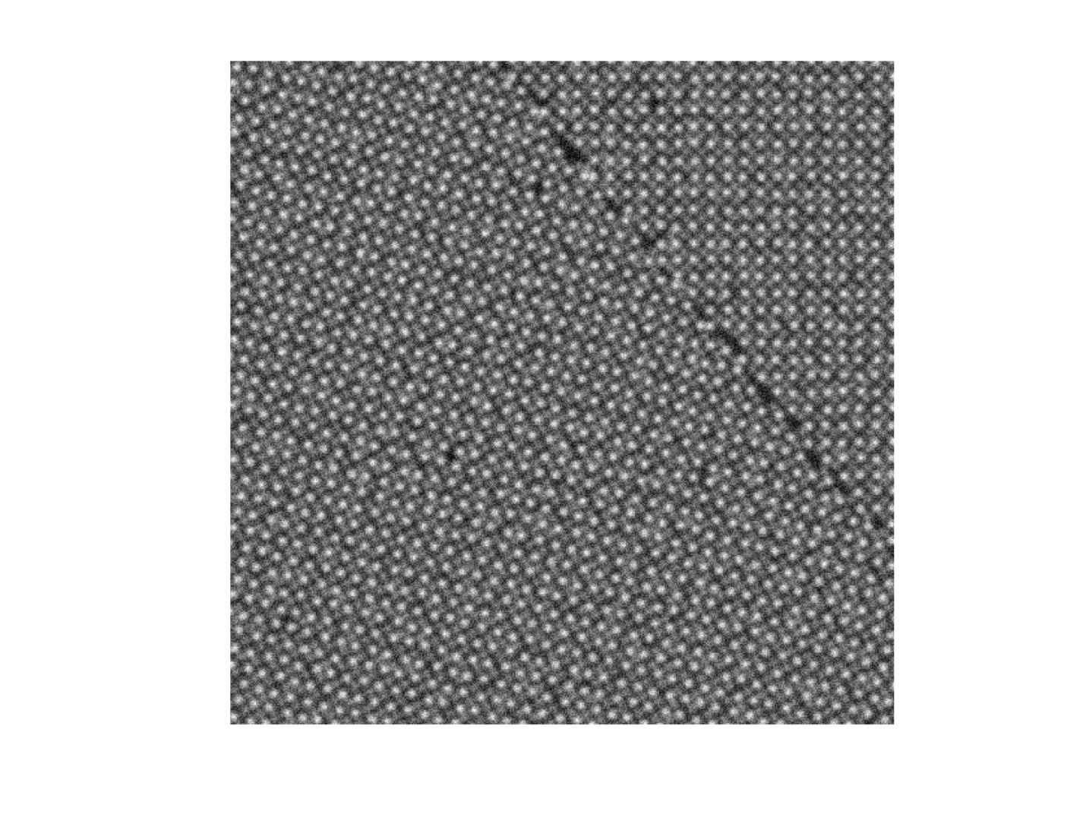
Cluster analysis
Perform clustering on PCA weighting vector from every pixel

Slide 16
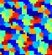

Cluster analysis
We can use local motifs to locate similar atomic arrangements across an image

Slide 17
Motif Matching

Slide 18
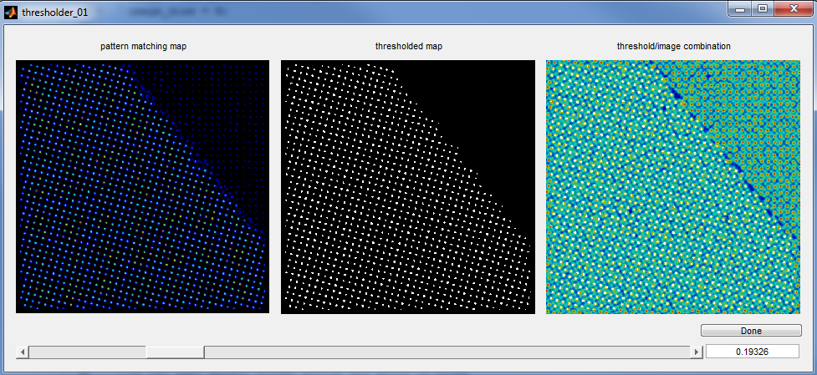
Motif Matching

Slide 19
Sliding Window PCA + Clustering
After motif matching…

Slide 20
Sliding Window PCA + Clustering

Slide 21
Sliding Window PCA + Clustering
Clustering of the first 32 PC’s

Slide 22
Sliding Window PCA + Clustering

Slide 23
Sliding Window PCA + Clustering
Original image
Denoised image
Removed noise

Slide 24
Sliding Window PCA + Clustering

Slide 25
Sliding Window PCA + Clustering
Found atoms

Slide 26
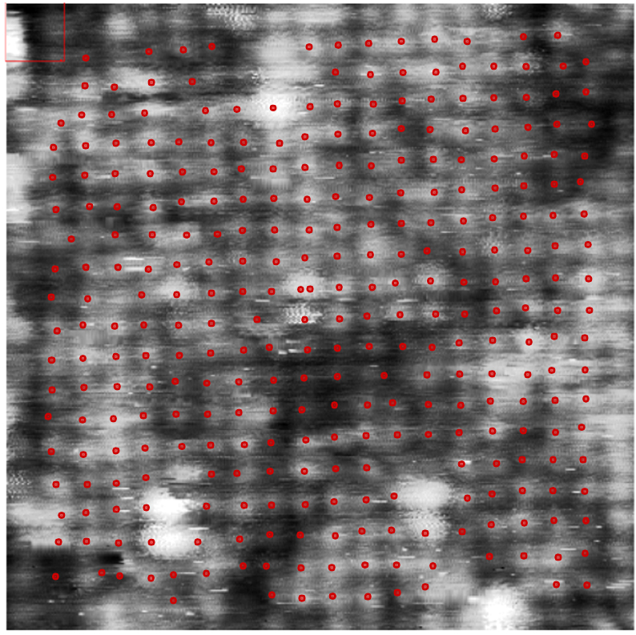
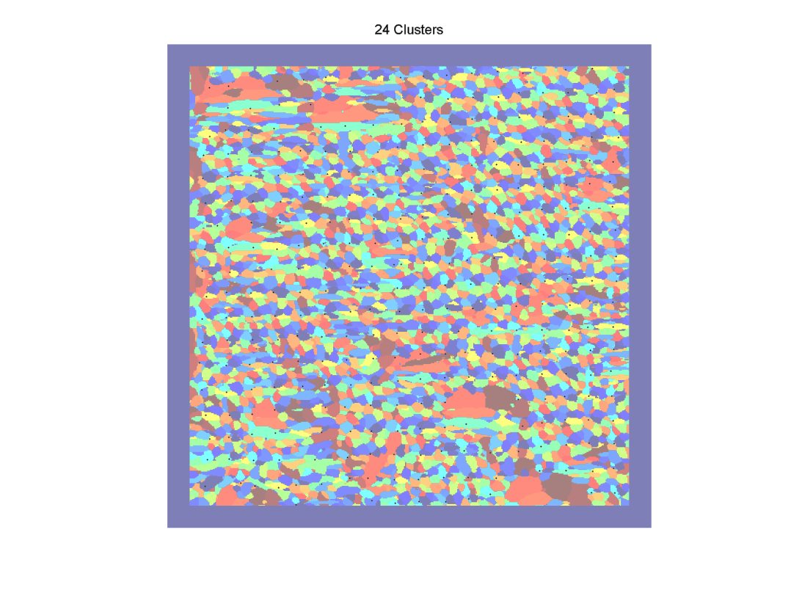
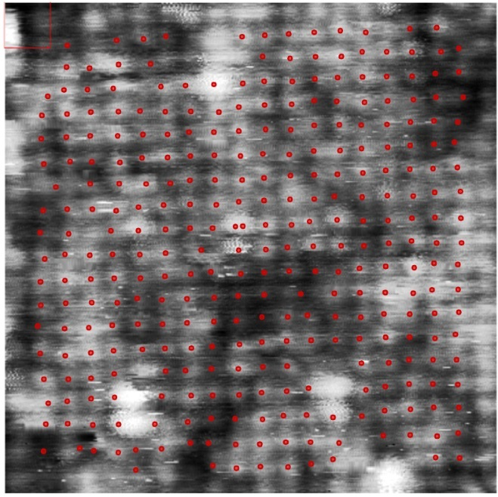
Sliding Window PCA + Clustering
original
cleaned
removed noise

Slide 27
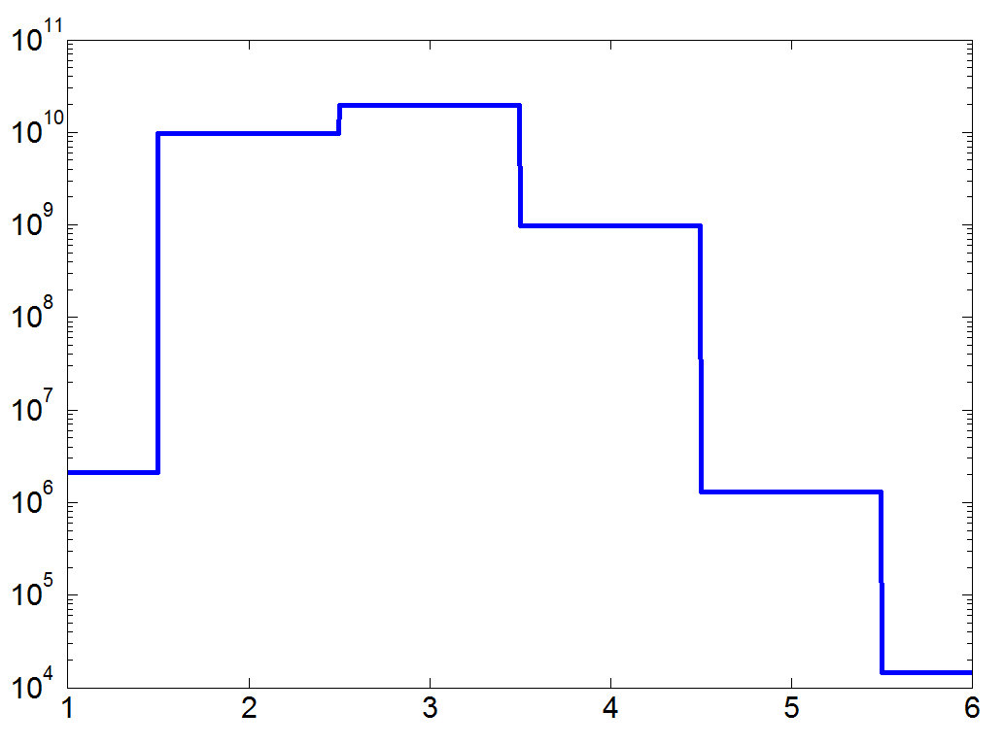
Sliding Window PCA + Clustering as Big Data
PCA
usefulness
Retain only 10% of PC
Scanned Window
Data Set
Memory Requirements
Original image
(512X512)
Computational
requirements
Clustered Data
List of found atoms

Slide 28
Alternate atom finding K-means on found atom positions

Slide 29
Multivariate Analysis of 4D STEM Data

Slide 30
Principal Component Analysis (PCA)
D → USV*
Eigenvectors:
-Orthogonalized Ronchigrams
Full data set
Diagonal matrix:
-ranked significance of PC’s
Matrix of loadings:
-maps of prevalence of particular PC’s
Compares every individual observable with every other observable
Find the most common behavior
Find the next most information rich (orthogonal) variation on the above behavior
Find the next most information rich (orthogonal) variation on the above behavior
… loop

Slide 31
Principal Component Analysis (PCA)
D → USV*
Scree Plot
-ranked significance of PC’s
Information rich
Information Poor
Less-correlated
Noise
Variance
Principle Component

Slide 32
Principal Component Analysis (PCA)
First 16 eigenvectors
First 16 loading maps
Scree Plot

Slide 33
Principal Component Analysis (PCA)
First 16 eigenvectors
First 16 loading maps
Scree Plot

Slide 34
Principal Component Analysis (PCA)
First 16 eigenvectors
First 16 loading maps
Scree Plot
PCA typically fails at: elucidating underlying physics
PCA typically succeeds at: - being fast and efficient
- de-noising
- data compression

Slide 35
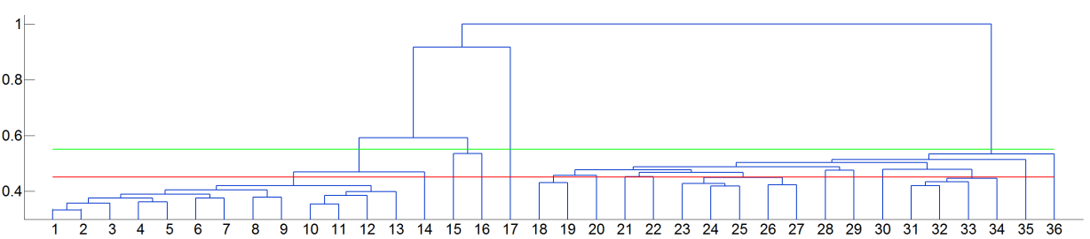
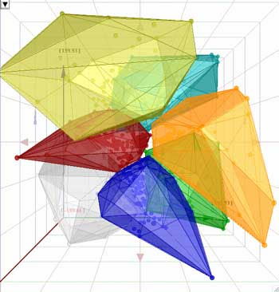
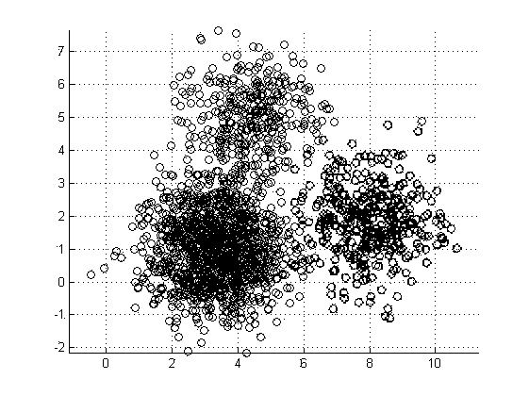
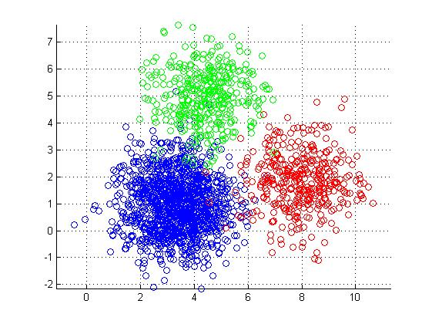
Cluster analysis
Group observables by “distance” to one another
Cluster
separation
Cluster number

Slide 36

Cluster analysis
K-means clustering: 36 Clusters
Ronchigram corresponding to each cluster
Cluster Locations

Slide 37
Cluster analysis
How many clusters is the right number of clusters?
Dendrogram
Cluster separation
Cluster label

Slide 38
Cluster analysis
How many clusters is the right number of clusters?
Dendrogram
Cluster separation
Cluster label

Slide 39
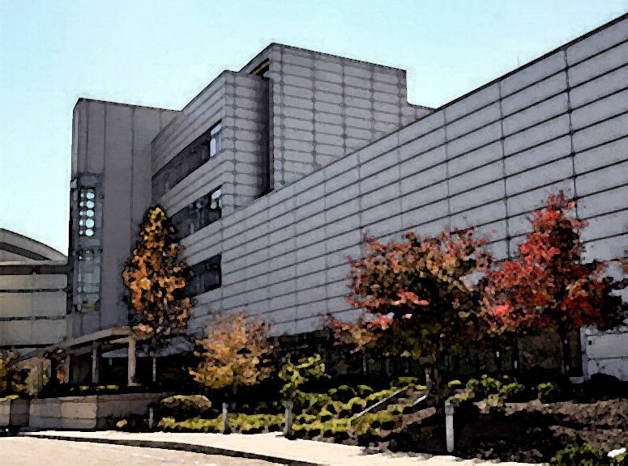

- Scientific user facility - 2 Page Proposal - sjesse@ornl.gov

